Slide 1





e-Application
Easy Finance
Presentation
Nov. 22, 2018

Slide 2
Agenda
# | Contents | Duration
1 | Atos Introduction & Reference | 10 mins
2 | Our Solution & Demo | 45 mins
3 | Why Atos | 5 mins
4 | Q & A | 30 mins

Slide 3
Atos Introduction

Slide 4
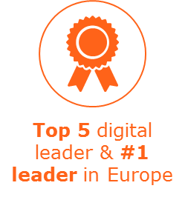
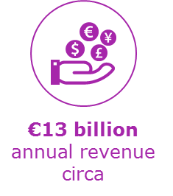
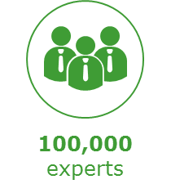


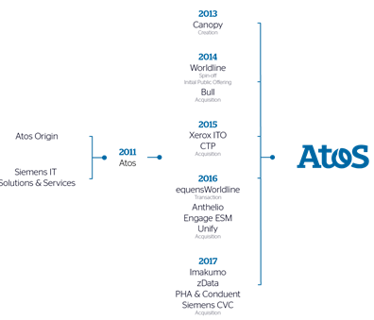
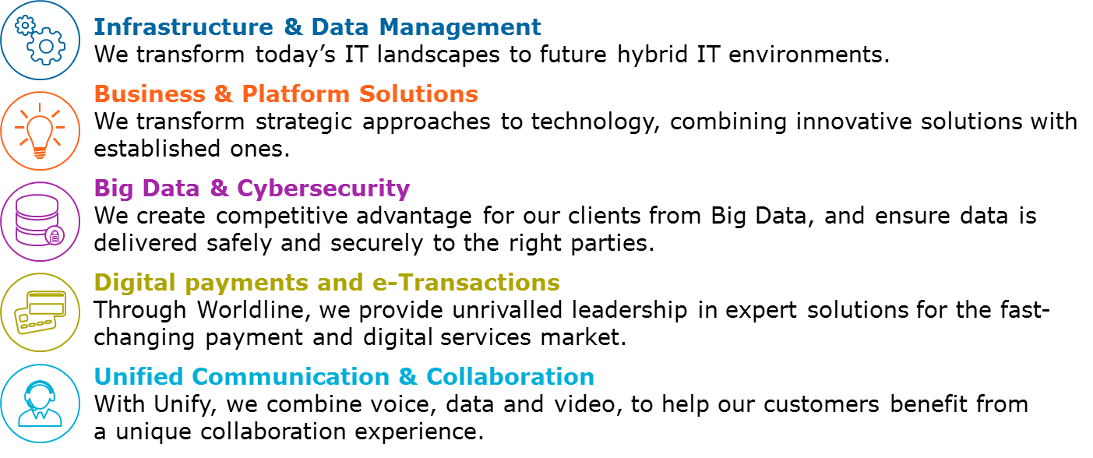










Atos at a glance Integrated Digital Services Leader – #1 in Europe
Proudest Claim: Our Manufacturing DNA, thanks to our
Philips, Xerox & Siemens History
Our unique ongoing partnership with Siemens
€ 300m spent on R&D and 5,000 patents

Slide 5
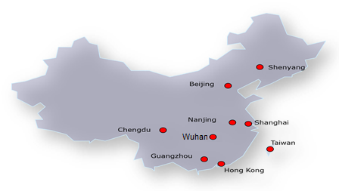



Atos in China At-a-glance
Offices located in 7+2 cities, 80+ Tier 3/4 cities/towns footprint coverage across China, with >1.500+ employees
Datacenters in Shanghai, Beijing and HongKong
Facts
Providing full range of end-to-end IT Services e.g. Consulting, System Integration, Managed Services and Cloud, Big Data and Cyber Security
Competence Center Country for Service Desk, ERP and Industry Solutions in APAC
Key solutions
Very strong in Manufacturing with multinational customers like Siemens, BMW, Volkswagen, Thyssen Krupp, BASF, Nike and Coca Cola and locals like Huayu Automotive, Patac, Dicastal
IT outsourcing provider for Siemens China with >40,000 users in 60 regional offices
Official Worldwide IT Partner for 2008 Beijing Olympic Games and 2014 YOG in Nanjing
Clients

Slide 6
Atos China Automotive Portfolio
Digital Factory & Enterprise
Industry4.0/China2025
PLM/MES/Mindsphere
CAx (R&D) Services
Remote Manufacturing
Industrial Data Analytics
Shop floor optimization
Digital Services and Products
Customer Experience and Multi Channel Commerce
Connected Vehicle and products
‘Mobile first’
Battle
for Talents
Digital Workplace
Unified Communication and Collaboration
Enterprise Mobility
GROW YOUR BUSINESS
Customer Centricity & Business Reinvention
IT Foundation services
Infrastructure transformation, operation and Hybrid Cloud services
Automation and robotics
Advanced analytics / CODEX
Internet of Things (IoT)
Application development, management and modernization
SAP end-to-end Services and HANA
DevOps and Agile Consulting and Transformation
DRIVE PROFITABILITY
Operational Excellence
Partner
Siemens, SAP, DELL/EMC, Microsoft, Start-Ups
DRIVE INNOVATION
Partner

Slide 7

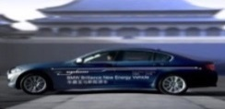
Atos is Strategic IT Supplier of BMW / BBA Successful operations and projects in China
BMW – CCAS Rollout and Maintenance Further adopt and rollout of the Company Car Administrative Management system
BMW - Global Testing – Penetration, Approval, Mobile and Source Code testing for NSC, FS,BBA
BMW – Online Sales platform Maintenance and development
BMW – i360 Charging Process Solution Development and Maintenance Charging Spot (Wall Box) application and installation process
BMW - Used Car Online Showroom Development and operation of the Platform for used cars in China
Solution development and operation
BMW BCS – R&D Onsite Support for Teamcenter and R&D Applications
BMW Brilliance – Zinoro Online Sales Development of the Zinoro Online Sales Portal
BMW Group – Agile Coach
Agile transformation support
BMW FS - RAD Development of Risk Assessment platform for financial services
BMW-Brilliance – Phoenix (SAP Application Management (SAP Basis and SAP Functions)
BMW-Brilliance – eHR / HCM Development and operation SAP HCM
BMW-Brilliance - Infrastructure Outsourcing
Server, Storage, Managed Network, Middleware, End-User Computing operation for BBA in China
BMW China - BMW Owners Club Center (BOCC) Public Cloud Migration (MS Azure) and Hosting
Infra- structure Services
BMW-Brilliance – Data Center Passive Operation and Infrastructure projects
Notes:
7

Slide 8


ATOS Services & Solutions For VWFS
FSO
A mobile solution of on-line application management for sales, dealers and customers in both Retail and Financial Leasing business lines
CCG
A master social platform (WeChat) integrated with contract information inquiry , customer service, payment channel and other financial functions
CPG
A solution to link VWFS core application and commercial banks, communicating accounting and payment information for both Retail and Wholesale business lines
PMS
A Champaign information management and approval system for brand, marketing, sales, OPE & risk users
E-Contract
Project management service and support for business applications
SQL Server Upgrade
Project management & test management support for 38 applications & projects
V-learn (HR Digital Learning)
Quality assurance and UAT management support for HR systems
CALMS
Professional performance test support for financial core applications
Business Intelligence
Project management & business analyst support for 7 BI applications & projects
BPM (K2)
System change management, customized development & maintenance for business process management system

Slide 9
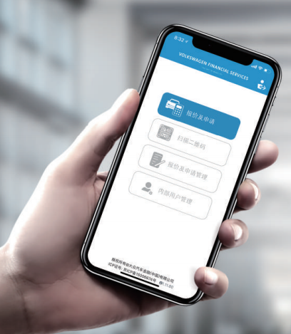
WWFS Financial Service China Online (FSO)
Business Challenge
Direct sales manually calculates the quotation proposals for different financial products in applications.
It takes time & effort to verify applicant’s identity information.
Application approval flow is not transparent for client.
More competitors start to use digital solutions to improve customer experience & visualization.
Solution
One-click generation for quotation proposals in mobile phone.
On-line application & quick identification for client’s identify information.
Real time tracking & reminder for application approval status.
Integration with E-contracting (E-signature) system.
Financial Service China Online provides a digital solution of application management for VWFS customers & dealers, in Retail & Financial Leasing business lines.
Benefit
Increase sales efficiency and mitigate diverting customers to competitors.
Reduce lead time & effort in application process, therefore to improve customer satisfaction.
Standard solution with customized functions to support multiple business lines.

Slide 10
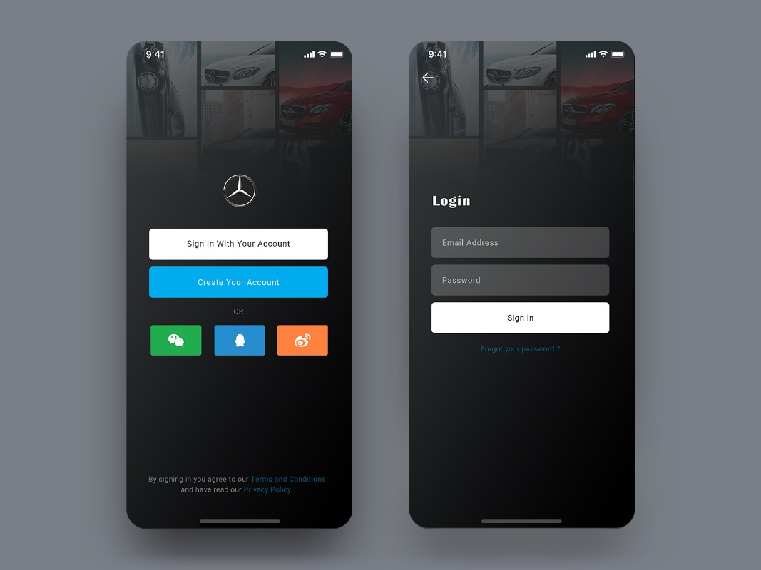
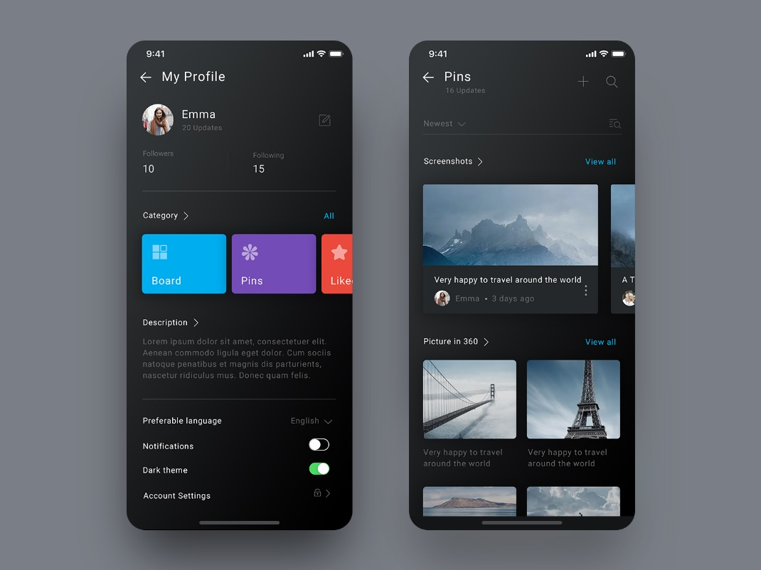
Mobile UI Design Reference

Slide 11
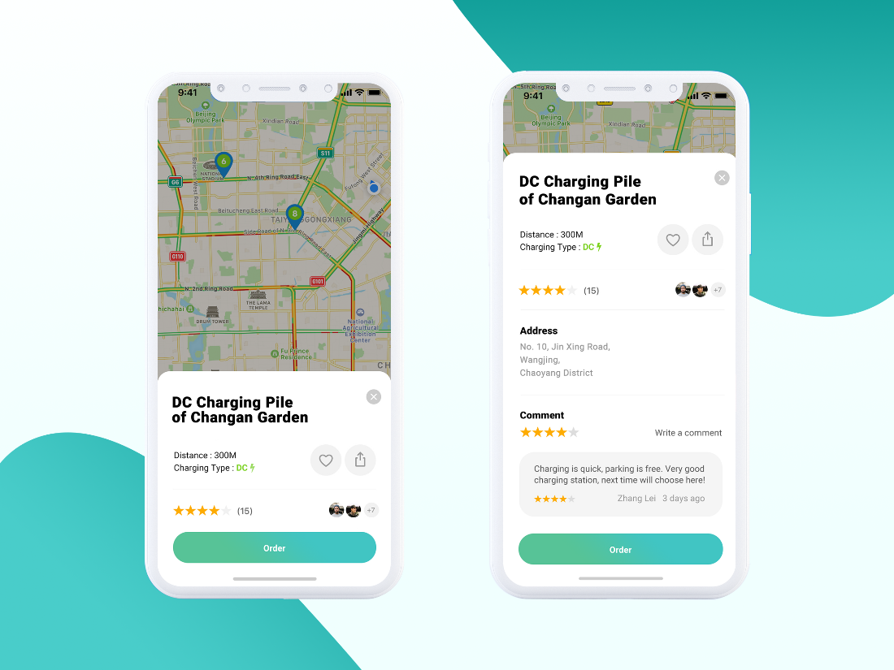
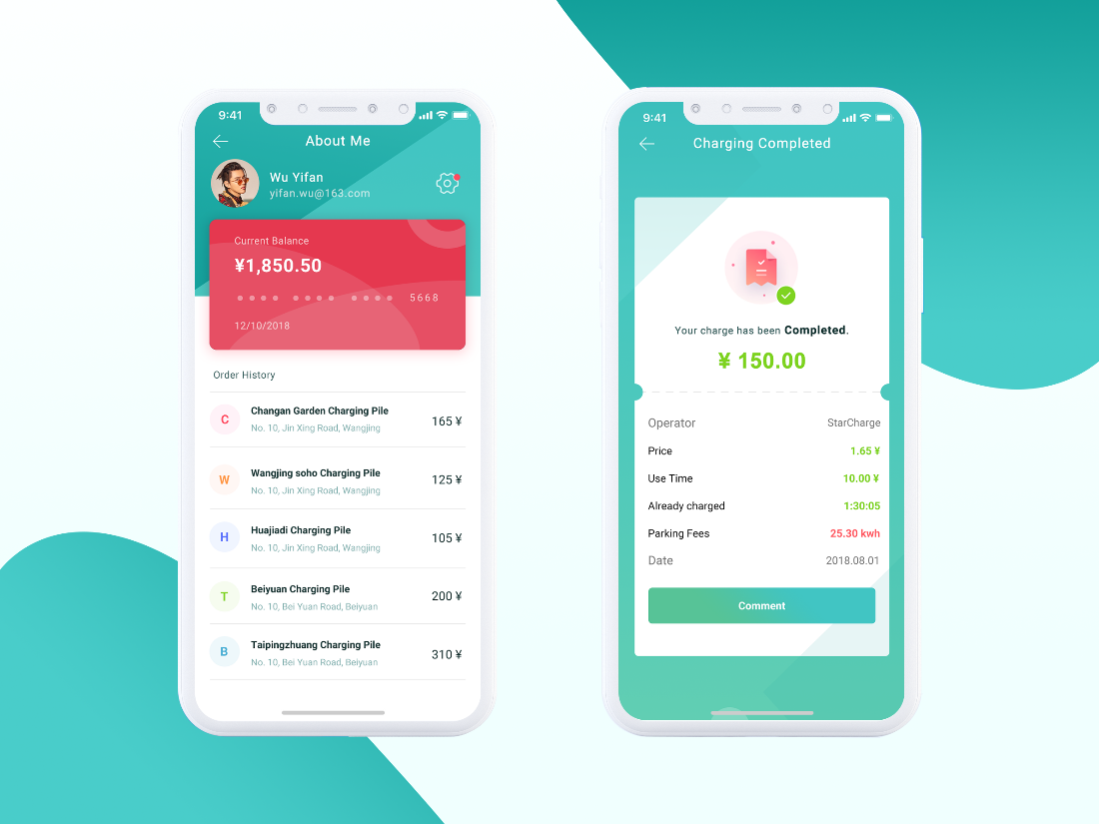
Mobile UI Design Reference

Slide 12
Our Solution

Slide 13
Topics
Our understanding & Implementation Approach
Functional Design
Technical Design
Project Management
Operation & Maintenance

Slide 14

Our Understanding Of Requirements & Implementation Approach
Open a new application channel to BMW AFC customers
Decrease customer effort and improve customer experience
Support sales to increase the application volumes
Better control operational cost by Innovation & Digitalization
e-application development
Integrated with DFE,COP
Integrated with e-authentication system
Operation
Maintenance
Objectives
Scope
Agile development/Onsite
Hybrid APP development architecture
JEE framework based
Separated frontend and backend
Microservice oriented architecture
Container management based
Data center hosted
Good UI/UE design
Experienced agile team
Select BA with auto finance background
Involve agile coach for continuous improvement
Involve DevOps expert for agile tool chain setup
Good quality of delivery
Familiar BMW process
Leverage experienced resource on easy finance
Solution
Overview
Development
Expertise

Slide 15

Function Overview
E-App
Identity Check
App download Service
Identification Service
NCIIC
Customer
Registration & Login Service
E-Signature Service
Bank Card / Union pay
Quotation Service
Digital Certificate Service
Face Recognition
Application Service
Preservation & Verification Service
OTP
Document Service
Timestamp Service
PBOC
DFE F&I
Configuration Service
User management Service
Certificate
Report Service
Trace record Service
Certificate Autthoriry(CA)
Officer Admin
Certificate Verify
Certificate
DFE

Slide 16




Main Business process
e-APP
DFE
1
2
3
4
Choose dealer, vehicle, financial product &
submit quotation
Download e-APP
Login
Register account
Customer
8
7
6
5
Login e-APP
Check the quotation information and confirm in DFE
Dealer F&I
Trigger the E-Authentication
Quotation confirmed
Authentication pass
Customer
9
10
11
12
Precheck
Submit the application form
Fill the borrower information
Upload mandatory document
13-2
13-1
Check pre-Check result
in DFE
Get next step information
Dealer F&I

Slide 17
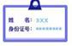









e-Authentication Face recognition, NCIIC verification,CA
Get name and ID
1:1
Pass
NCIIC
SeekTruth
(ocr+ face reorganization)
Vivo detection
CA
Certification
Name
ID number
+
Card number
Phone number
China Union Pay

Slide 18
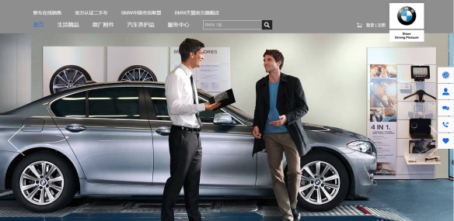
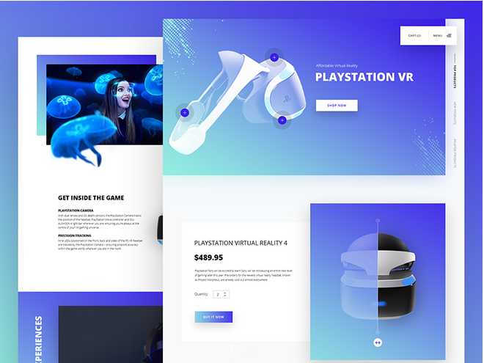
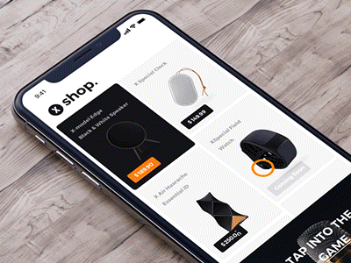

Trends of UI/UE Design
Flat and Simple
Gradient
Interactive
Card + Shadow
Focus on Typography
Icon change
Notes:
Value Proposition:
The consequences of interruptions in business and the cost of remediation can far outweigh the cost of prevention. We help our clients detect the risk of this happening early, and therein lies the primary business value of testing. By leveraging our assets, knowledge base and service offerings, clients can reduce their testing spend by as much as 40%.
The Atos mature & highly industrialized Testing* capability, delivers pragmatic & risk-based services, and secures business continuity. Testing is a way of delivering compliant operation, protection of data & reputation and the ability to meet core objectives. Getting it right leads to our clients achieving improvement & innovation faster and at lower cost than their competition; supports getting to market rapidly, compliancy and ability to make decisions based on business risks.
The verticalized Testing portfolio innovatively combines deep domain knowledge – anchored in Testing Centres of Excellence (TCoEs) in the GDCs & GBUs – and technical testing expertise, addressing client-specific contexts. The main offeringis “Scalable Managed Testing Services”: which offers unmatched flexibility, improved application quality and cost reduction.

Slide 19
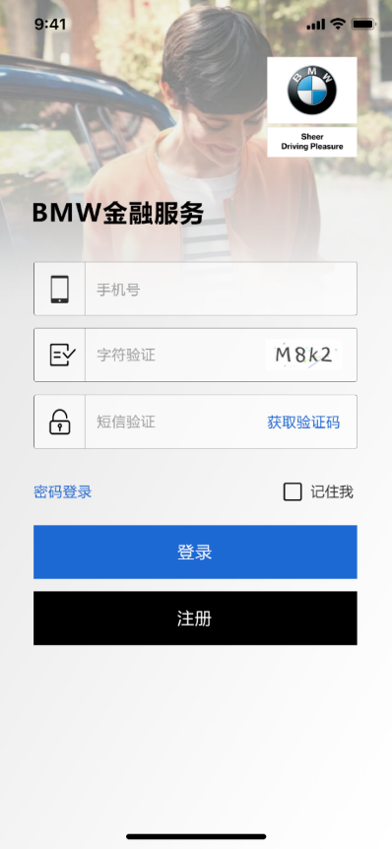
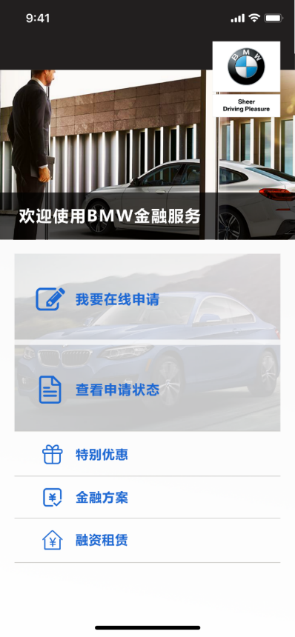
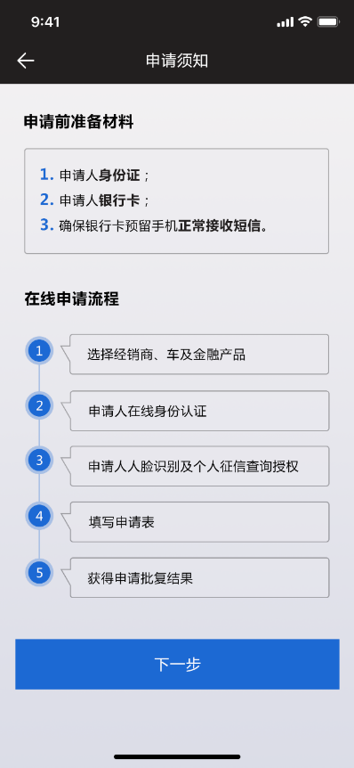
UI Design Demo
Notes:
Value Proposition:
The consequences of interruptions in business and the cost of remediation can far outweigh the cost of prevention. We help our clients detect the risk of this happening early, and therein lies the primary business value of testing. By leveraging our assets, knowledge base and service offerings, clients can reduce their testing spend by as much as 40%.
The Atos mature & highly industrialized Testing* capability, delivers pragmatic & risk-based services, and secures business continuity. Testing is a way of delivering compliant operation, protection of data & reputation and the ability to meet core objectives. Getting it right leads to our clients achieving improvement & innovation faster and at lower cost than their competition; supports getting to market rapidly, compliancy and ability to make decisions based on business risks.
The verticalized Testing portfolio innovatively combines deep domain knowledge – anchored in Testing Centres of Excellence (TCoEs) in the GDCs & GBUs – and technical testing expertise, addressing client-specific contexts. The main offeringis “Scalable Managed Testing Services”: which offers unmatched flexibility, improved application quality and cost reduction.

Slide 20
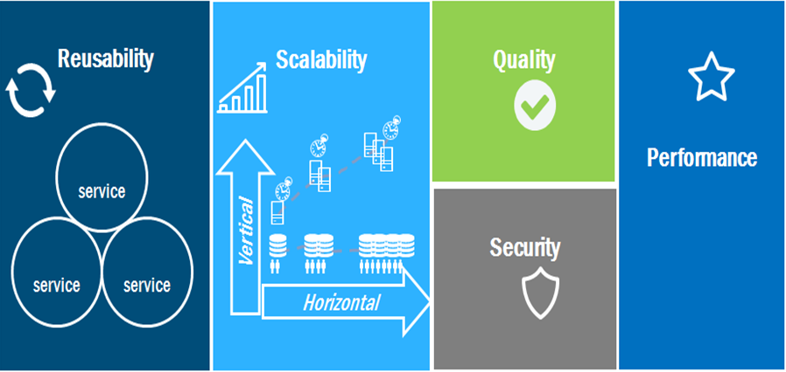
Technical Design
System Design Rules
Notes:
Value Proposition:
The consequences of interruptions in business and the cost of remediation can far outweigh the cost of prevention. We help our clients detect the risk of this happening early, and therein lies the primary business value of testing. By leveraging our assets, knowledge base and service offerings, clients can reduce their testing spend by as much as 40%.
The Atos mature & highly industrialized Testing* capability, delivers pragmatic & risk-based services, and secures business continuity. Testing is a way of delivering compliant operation, protection of data & reputation and the ability to meet core objectives. Getting it right leads to our clients achieving improvement & innovation faster and at lower cost than their competition; supports getting to market rapidly, compliancy and ability to make decisions based on business risks.
The verticalized Testing portfolio innovatively combines deep domain knowledge – anchored in Testing Centres of Excellence (TCoEs) in the GDCs & GBUs – and technical testing expertise, addressing client-specific contexts. The main offeringis “Scalable Managed Testing Services”: which offers unmatched flexibility, improved application quality and cost reduction.

Slide 21


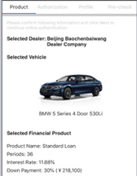
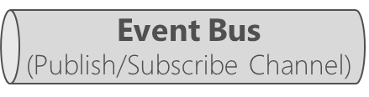

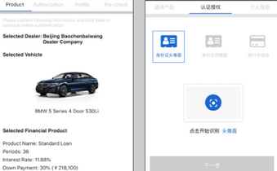

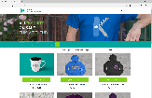
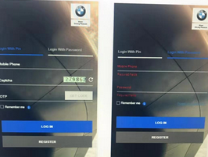
Technical Design
Application Architecture-Microservice
Client apps
Docker Host
Identity microservice (Reg+users)
API Gateway
E-app mobile app
SQL Server db
OS:
iOS
Android
Container
SF Product microservice
JSON
SQL Server db
Axway API
Management
Application microservice
E-app management Web app
WebApp MVC
SQL Server db
Redis cache
HTML
Servlet
E-Auth microservice
HTML
SQL Server db
Pre Check Management
microservice
DFE application
JSON
SQL Server DB
Documents microservice
SQL Server DB

Slide 22











Technology Stack .Net Core Framework
Presentation Layer
Service Layer
Application Layer
OS Layer
Infra. Layer
Data Center
QG
QG

Slide 23

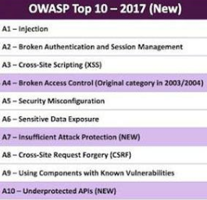



Technical Design
Security design, Pen&CR
HTTPS – we are using security internet protocol for web contact transfer.
Data Encryption – Data will be encrypted by MD5.
Top 10
Always think out the security improvement
during designing, developing and implementation.
We adopt the methodologies of OWASP during system designing and development
Notes:
1 业务与服务分离的方式设计整个平台，开放了Order Production服务满足不同业务功能的需求，这些Reusable Business Service
不但可以供内部系统所使用还可以与其他系统进行数据传输，最大的程度实现服务可复用性。方便的开关这些服务。
2 为了能实现短平快的高速变化的业务需求，定制功能也是采用面向服务的方式进行开发的，无论是新的服务或者是现有服务，只要按照Java的标准语言开发与我们提供服务标准进行开发服务，就可以把注册到现有平台。被功能模块提供服务。这样就可以大大提升整个平台的System scalability and extensibility。

Slide 24












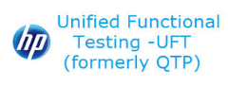









DevOps Practice Tool enabled lifecycle is key to DevOps success
JEE/.NET TECHNOLOGIES
Planning & Feedback
Requirements traceability with Test cases
Integrated Development Environment (IDE)
Version
control
Build Tools
Quality Control
Deploy to test
Monitoring
Prod
Deployment
Pre-Prod deployment &
Infra Testing
Prepare Release Ready Build
Packaging
Integration Testing

Slide 25


Project Governance
Demand Organization
Supply Organization
STRATEGIC
N.N
Steering Committee
Account Executive
Huang Cong/ Ivy Li
Escalation
Management and Decision
Quarterly Review*
N.N
TACTICAL
Service Delivery Manager
Huang Cong
Management Committee
Change Advisory Board
Service Level Review
Innovation
Board
Architecture
Board
OPERATIONAL
Project manager
Service Delivery Meetings
Project Manager
Regular Status Meeting
Maintenance
Development
Operation
QG
QG

Slide 26
Project Management Team
Resource Pool
PM/PO
Project manager
Scrum Team
Business Analyst
Business Analyst
Architect
Architect
PM/ScrumMaster
DevOps Expert
UI Designer
DevOps Expert
Developer
Developer
Tester
Tester
QG
QG

Slide 27

Easy Finance - Timeline
Sep
Oct
Nov
Dec
Jan
Feb
Mar
Apr
May
Jun
Jul
Aug
Sep
Oct
Nov
Activity
03.
10.
17.
24.
01.
08.
15.
22.
29.
05.
12.
19.
26.
03.
10.
17.
24.
31.
07.
14.
21.
28.
04.
11.
18.
25.
04.
11.
18.
25.
01.
08.
15.
22.
29.
06.
13.
20.
27.
03.
10.
17.
24.
01.
08.
15.
22.
29.
05.
12.
19.
26.
02.
09.
16.
23.
30.
07.
14.
21.
28.
04.
11.
18.
Parties
Exploration
09/03/2018 - 12/31/2018
Purchasing Process
10/09/2018 - 12/31/2018
Grips ticket creation
10/08/2018 - 11/30/2018
Project Setup
10/08/2018 - 11/30/2018
Project Exploration
12/01/2018 - 12/30/2018
Infra Ordering
12/01/2018 - 01/20/2019
Sprint Execution
S1
S2
S3
S4
S5
S6
S7
S8
S9
S10
S11
S12
S14
S15
S16
Go live - Nov
11/15/2019
5B- Stability
Go live- Jul 07/21/2019
Project Closure
11/18/2019 - 12/15/2019
COP
DFE
COFIS CS
EDMS
Official Website
UniPay
Web Calculator
CA Platform
01/01/2019 - 11/17/2019 Project implementation

Slide 28
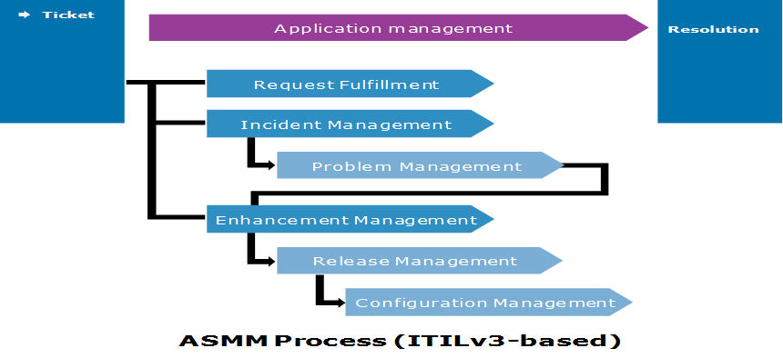
Maintenance & Operation ITPM Agile Process
Incident Process
Problem Process
Service Request
Change Process
Release Process
Configuration Process
Knowledge Process
Based upon BMW requirements Atos upgraded the whole quality management process
QG
QG

Slide 29
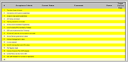

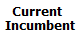
Transition Plan Approach
1 Week
1 Week
1 Week
1 Week
Preparation & Planning
Discovery (Knowledge Transfer)
Job
Sharing (Shadow)
Service Demo (Reverse Shadow)
Hand Over
Planning of training session
Conduct joint meetings between Atos, VW& present incumbent to identify the Knowledge areas in scope for transition for each application
Finalize KT Model & Plan
Check List
Identify the list of all documents required at the time of KT
Release meeting invite to all trainers for KT
Finalize day wise KT plan
Conduct KT /Training workshops
Update/create knowledge documents such as application manual, FAQs etc.
Record KT session
Document the Knowledge Transfer
Reverse KT/Review sessions
Conduct work shadowing
OJT (On Job Training). work with SMEs (Incumbents)
Observe execution of actual tasks as performed by the SMEs
Atos working on tickets in consultation with the present incumbents
Final assessments
Atos independently works on tickets with the present incumbent on stand-by
Complete any missing or pending documentation
Measure Atos team performance against contractually agreed SLA/KPI‘s
Atos responsible & have met and fulfilled all critical deliverables
Sign-off
Reviews
Reviews
Reviews
Sign-off
All KT capture docs. and final sign-off will be done by BMW
Reverse KT ratings from Incumbent & BMW leads to be assessed & mitigations will be drawn for Job sharing & Service Demo (Shadow-)Phases
Atos Teams will measure the KPI’s/SLA’s as agreed and will report the progress on a weekly basis. This will also be the basis to demonstrate the readiness to move to steady state
Daily calls to monitor the KT, job sharing & service demonstration phase between leads of all three parties
Joint Sign off process by BMW and Atos with inputs from the current incumbent teams
Sign-off Process
Transition Governance
Transition Management
Input
Reviews

Slide 30
Why Atos

Slide 31
Why Atos? Our Advantage
We know
Your System
We know
Your Business
Agile
Experience
DevOps
Mindset
We know
Your IT ENV
We know
Your Process
Micro
service
High
Quality
We know
You
Mature
Team

Slide 32
Q&A

Slide 33
Thanks For more information please contact: M+ 86 13671197177 liping.yang@atos.net

